Slide 1
Clustering High Dimensional Data
Notes:
We will talk about clustering high dimensional data. In the first portion of the talk, we explain the challenges of this task. Then we present results from data exploration that will hopefully lead to inspiring discussions and good ideas!

Slide 2
Code and this slide deck: https://github.com/vpoulin/HighDimensionalClustering /notebooks/00-GettingData.ipynb /notebooks/00-GettingStarted.ipynb /reports More complete motivations: Leland’s talk on high dimensional clustering

Slide 3


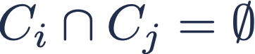
Given
Return
Such that
and
Notes:
One definition of clustering is that we have points from some metric space, and we want to return a set of non-overlapping subsets of those points. There exists a large number of variants of this definition, but we will focus on this one.
Evaluating clustering methods is hard, unless we have ground truth clusterings. As we have seen yesterday, artificial benchmarks are often used for this purpose. But, as we will see later, high dimension is non intuitive, so we want to avoid relying on a generative model that might generate data with different properties than what is observed in real applications.
For this reason, we will use real labelled high dimensional datasets as our benchmarks.

Slide 4
Datasets
Notes:
All of these should be considered “toy datasets”, small and easy, but they’re still good enough to highlight the challenges of clustering high dimensional data. Doing well on these is a necessary, but not sufficient condition for a good high dimensional clustering algorithm.

Slide 5
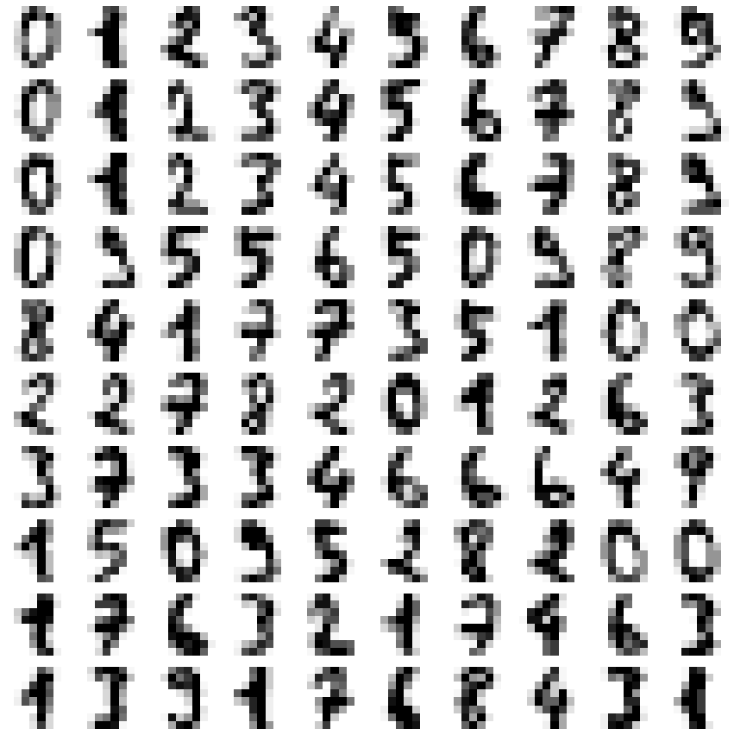
Pen Digits
Images of hand drawn digits
1797 images
8x8 pixels
Translates to 64 dimensional vectors
A good “small” dataset that isn’t too high dimensional
Notes:
The first dataset in pen digits. Its about 2000 images of hand-written digits. It is small enough that you don’t really need to worry about making your algorithm run fast.

Slide 6
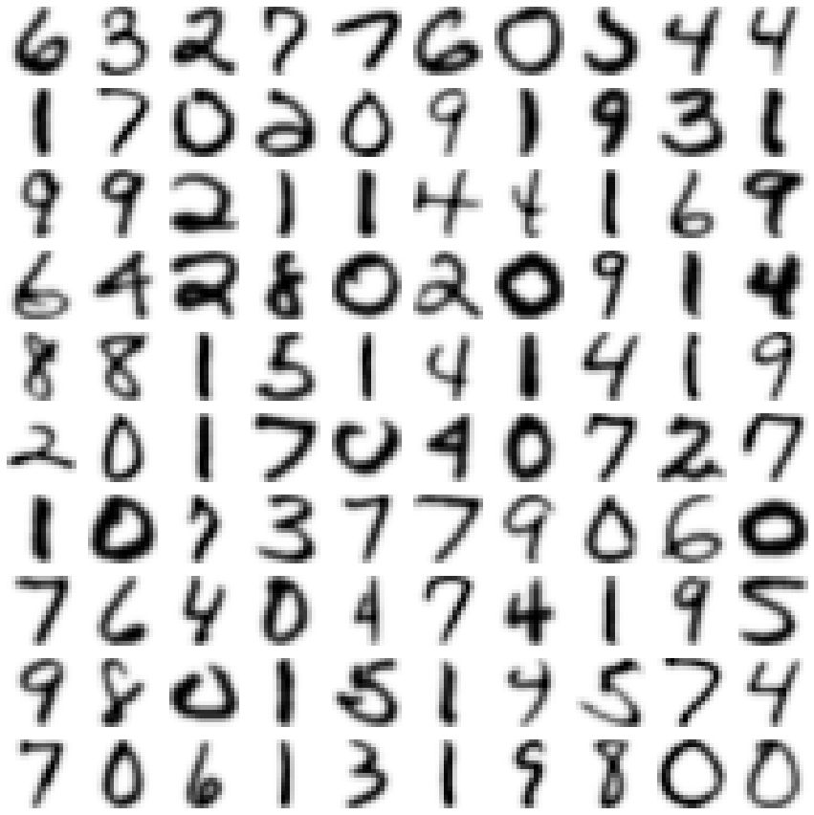
USPS Digits
Images of hand drawn digits
9298 images
16x16 pixels
Translates to 256 dimensional vectors
Higher resolution than pendigits, not too large a dataset
Notes:
Next up is USPS digits. Higher dimensionality, larger dataset (about 10,000 samples). This provides a nice step up from pendigits.

Slide 7
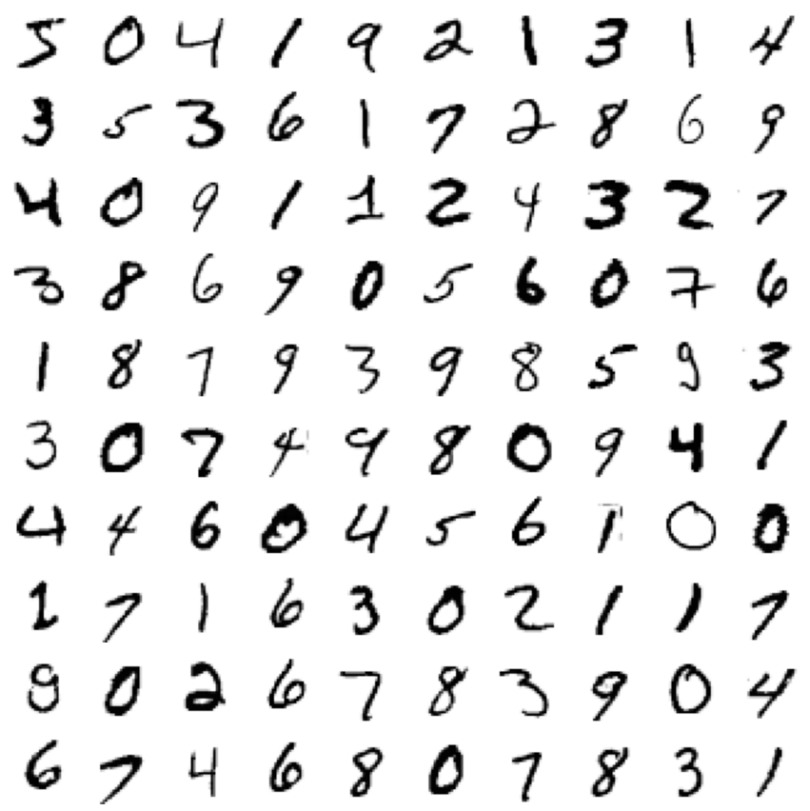
MNIST Digits
Images of hand drawn digits
70000 images
28x28 pixels
Translates to 784 dimensional vectors
Higher resolution and a good scaling test for clustering
Notes:
Stepping up again in handwritten digits we have MNIST digits, with 70,000 digits and higher resolution again (now 784 dimensional).

Slide 8
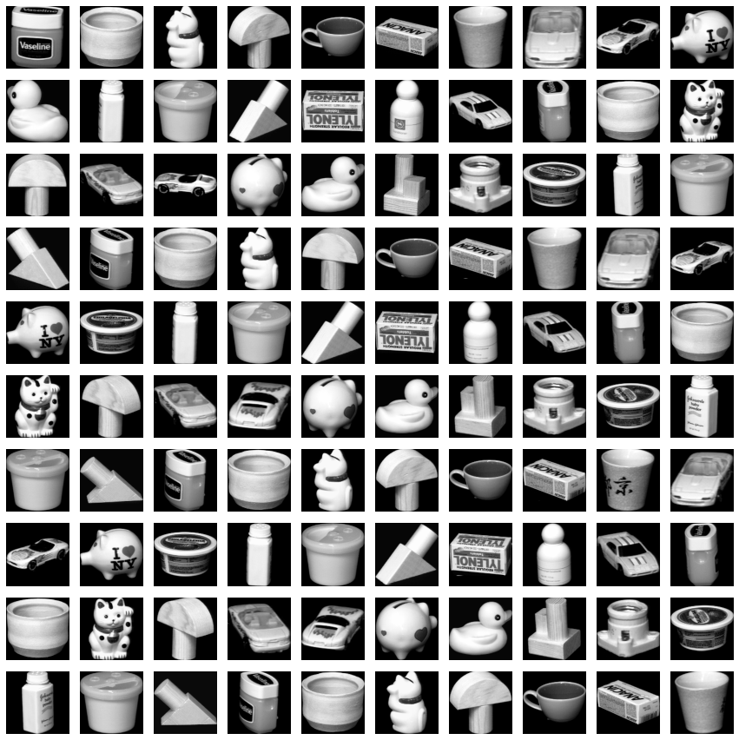
COIL-20 Objects
Photos of 20 objects from 72 angles
1440 images
128x128 pixels
Translates to 16384 dimensional vectors
High resolution and more complex images
Notes:
Different data this time in even higher dimension. We have pictures of 20 objects photographed from 5 degree angles around the object.
Different objects *should* form nice clusters.

Slide 9
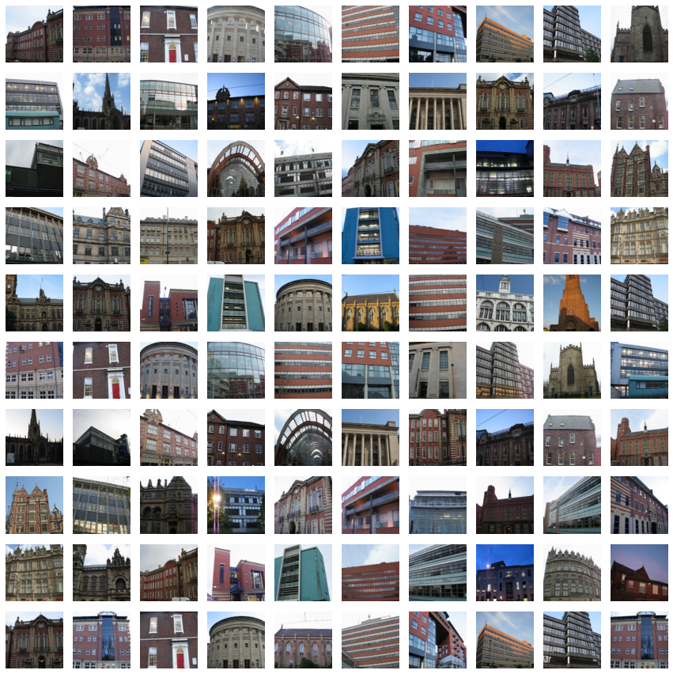
Sheffield Buildings
Photos of 40 buildings from different angles and lighting conditions
4178 images
rescaled to
96x96 pixels
Translates to 27648 dimensional vectors
High resolution complex images with colour channels
Notes:
Last we have pictures of 40 different buildings). Much challenging because of the different angles, different lighting conditions. The fact that the photos are in colour also mean we have to deal with three separate colour channels, resulting in very high dimensional data.

Slide 10
Clustering algorithms
Notes:
Let’s look at some common clustering algorithms on metric spaces.

Slide 11
K-Means
Notes:
We will start with K-Means.

Slide 12

Notes:
K-means starts by randomly placing initial centroids, assigning points to their closest centroid, and then moving the centroid to the average of the points assigned to it. By assigning points to their closest centroid, the algorithm indirectly assume that clusters are spherical.

Slide 13
Single Linkage

Slide 14
Start every point as a cluster
Merge the closest pair* of clusters
Repeat until there is only one cluster
* Distance between two clusters is the minimum of any pair of points from each cluster
Notes:
Progressively merging clusters by merging the closest pair of clusters at each step – where the closeness of clusters is the minimum distance between them.

Slide 15
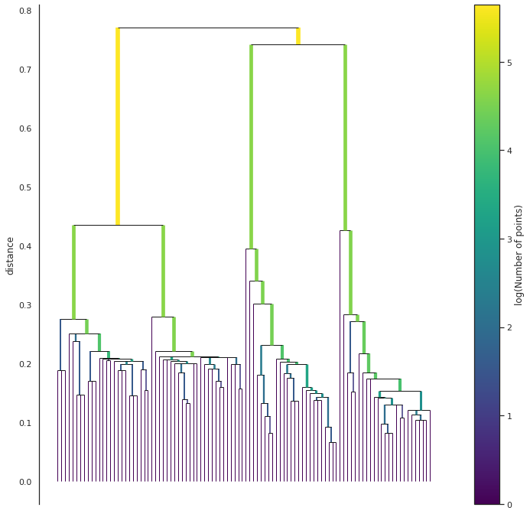
Cut here!
Notes:
This yields a a hierarchy, we then choose a cut.
Eliminates the assumption of spherical clusters.

Slide 16
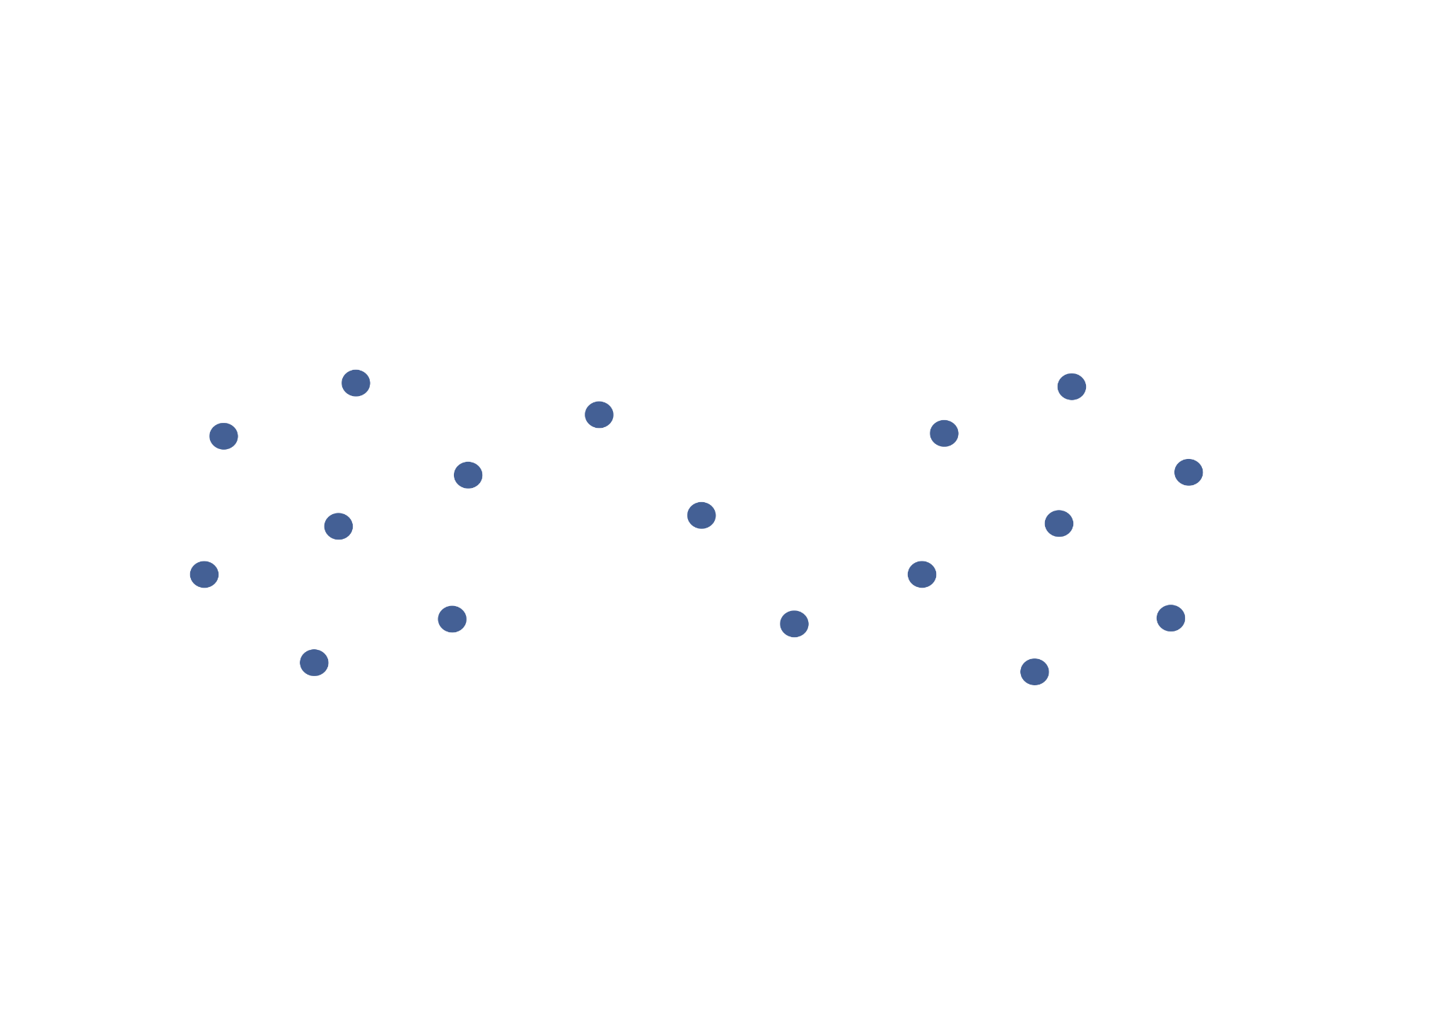
Notes:
However, it suffers from noise forming bridges.
Here we have 2 clusters, with a narrow bridge across the middle caused by a little bit of noise.

Slide 17
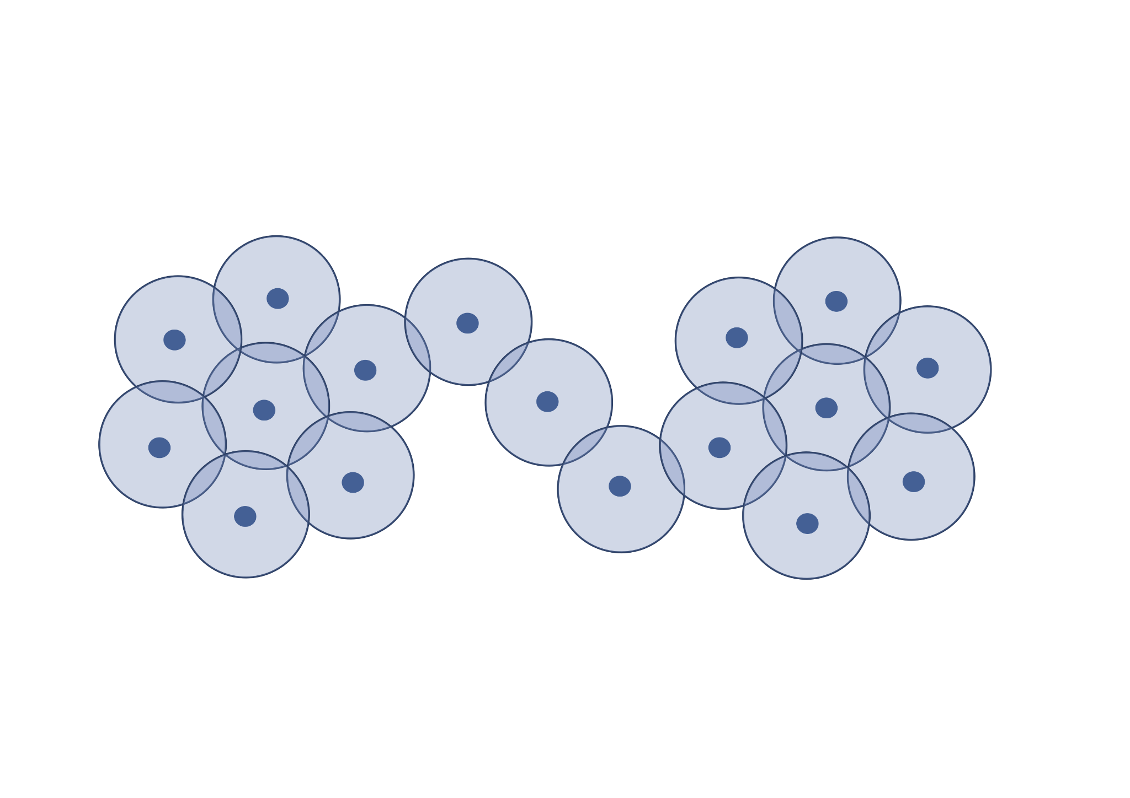
Notes:
The two clusters are merged together via the bridge at essentially the moment they form.
If we were to try to extract a 2 cluster solution to this we would likely get one very small cluster (possibly just a single point), and the rest.

Slide 18
Complete Linkage

Slide 19
Start every point as a cluster
Merge the closest pair* of clusters
Repeat until there is only one cluster
* Distance between two clusters is the minimum of any pair of points from each cluster
Notes:
Complete linkage same as single linkage with distance between two clusters being the maximum of any pair of points from each cluster.
Eliminates the noise problems of Single Linkage, but we still have the drawback that clusters are required to be “spherical”.

Slide 20
HDBSCAN
Notes:
Single linkage is nice because it allows for all sorts of cluster shapes, but it suffers from noise. We kind of over-corrected for it with the complete linkage. HDBSCAN is trying to solve this.

Slide 21
Improve Single Linkage by introducing a density requirement
Notes:
It improves single linkage clustering by introducing a density requirement: a point can’t be merged with a cluster unless it is dense.
And density is measured by having a sufficient number of neighboring points for some epsilon-balls.

Slide 22
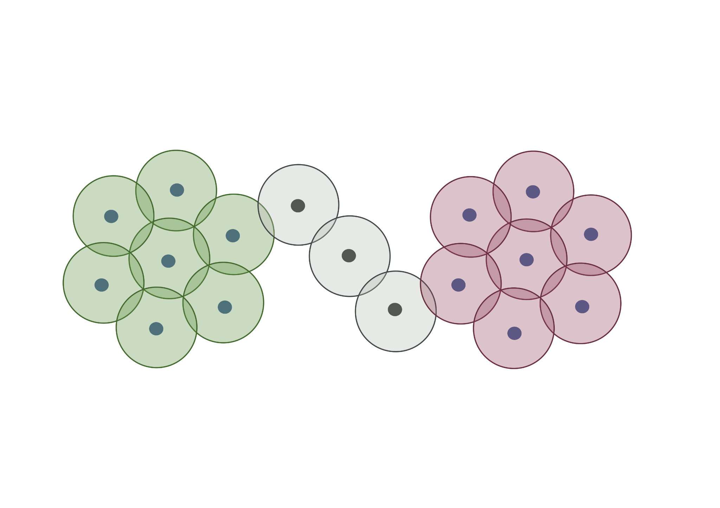
Notes:
In this example, the three points forming the bridge only touch 2 neighbours each, while the clusters on either side have at least three. So it is possible to find a density threshold that avoids merging across the bridge too early.

Slide 23
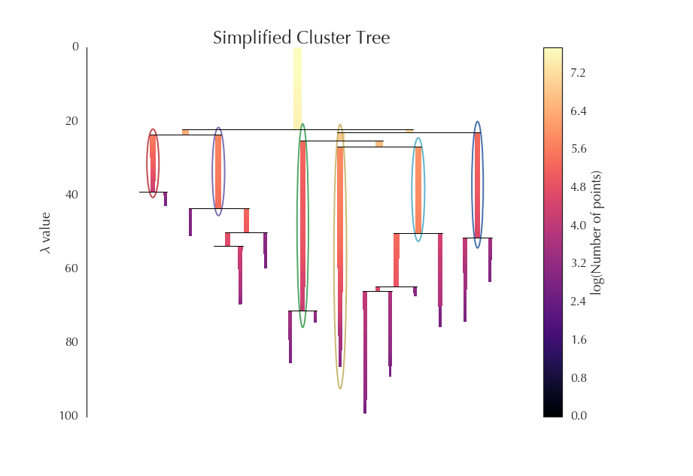
Notes:
Just like for single linkage, we build a dendogram.
DBSCAN: has a single cut for all.
HDBSCAN: solves an optimization problem. It trys to pick clusters to maximise their number of points by their persistence time.

Slide 24
Clustering in high dimensions
Notes:
So how do these clustering algorithms do on the high dimensional data when we just apply it to the raw high dimensional data?

Slide 25
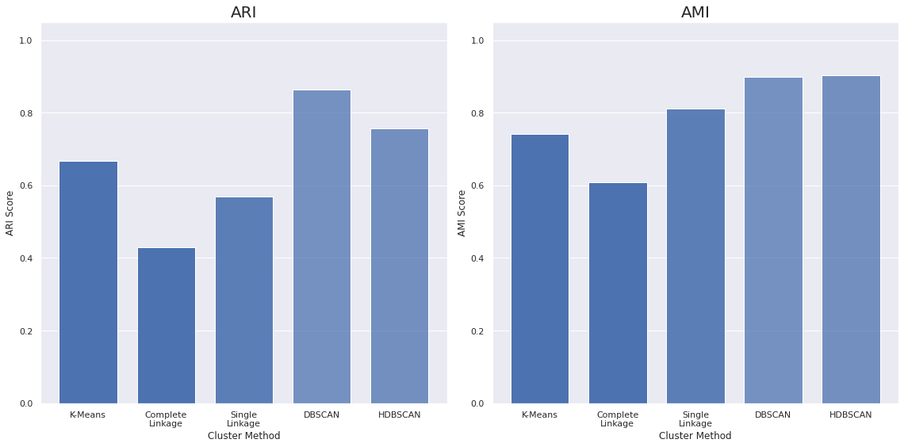
Pen Digits
Notes:
This is a small dataset in only 64 dimensions.
ARI and AMI are ways of scoring how well the clustering matched the ground truth clusters. 1.0 means a perfect match, 0.0 means random.
Here, we are doing okay. Note that the DBSCAN and HDBSCAN results are faded because they didn’t cluster all of the data and the scores are just for the data they did cluster. The saturation of the colour indicates the proportion of points that were actually clustered and not identified as outliers.

Slide 26
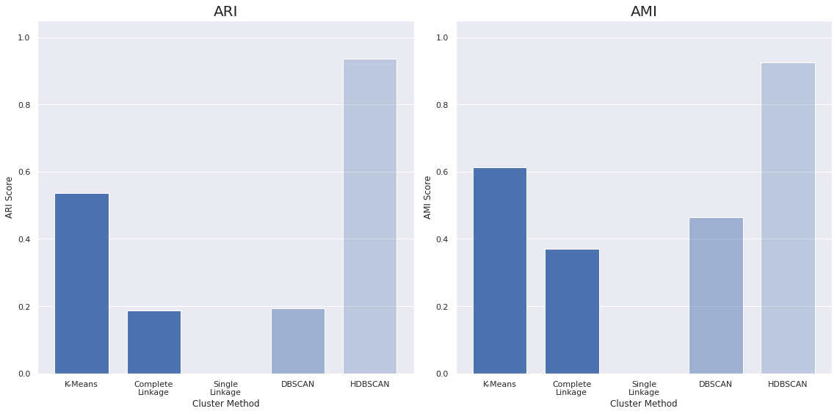
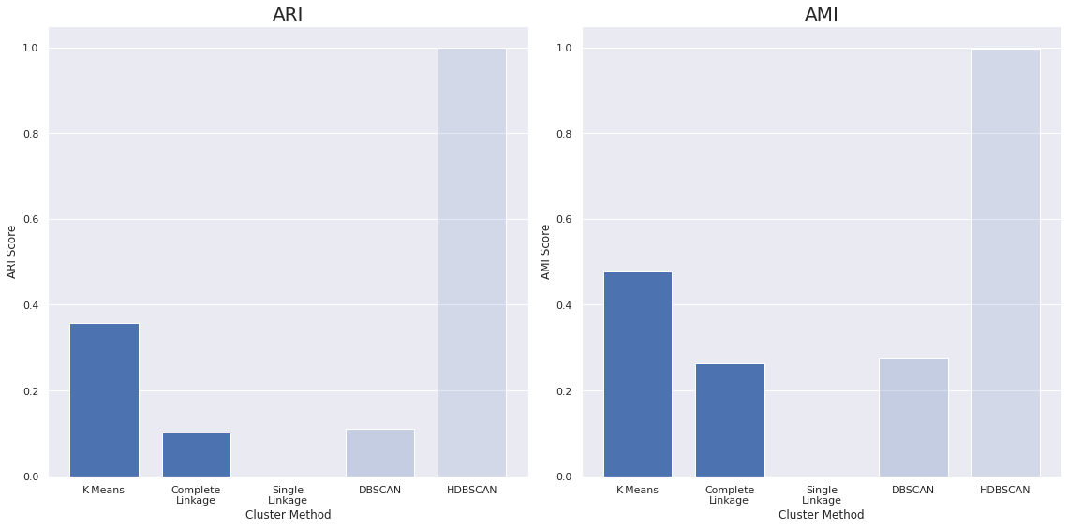
USPS Digits
MNIST Digits
Notes:
The other digit datasets. With USPS we see huge changes. Single linkage breaks, HDBSCAN does well on the data it clusters, it clusters a very small amount of the data. K-Means gets middling scores.
Once we scale up to MNIST we see these same effects even more.

Slide 27
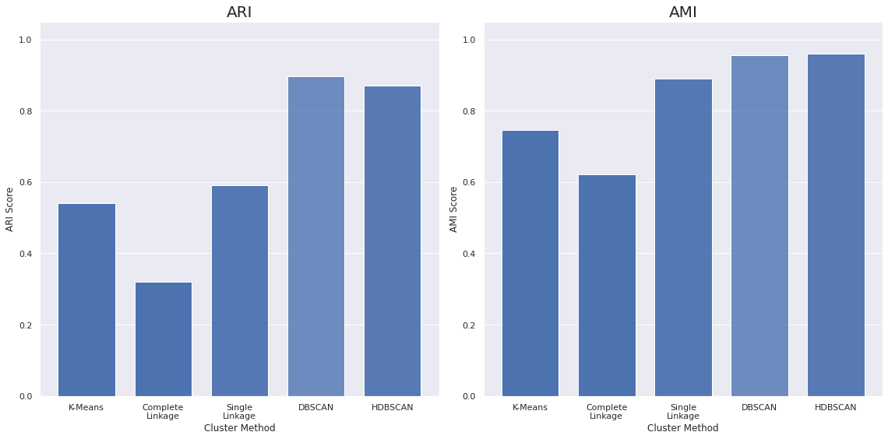
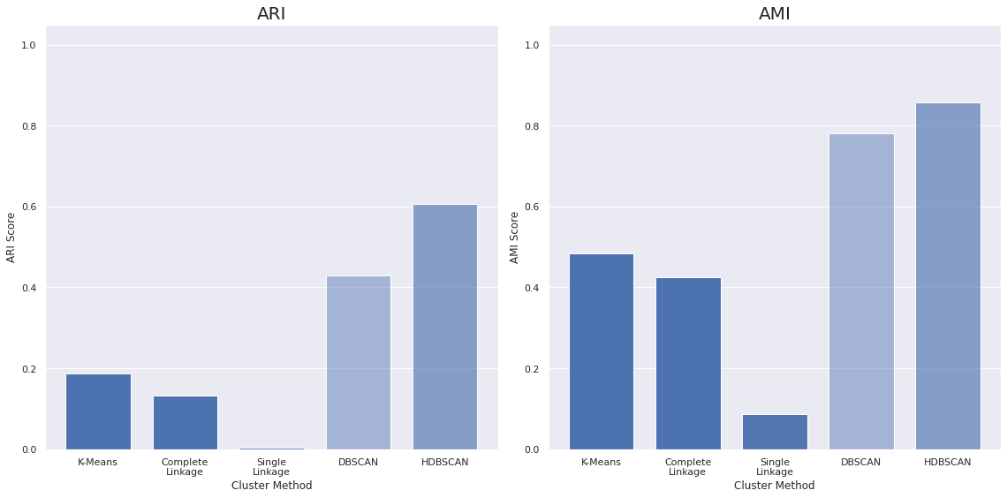
USPS Digits
MNIST Digits
COIL-20 Objects
Sheffield Buildings
Notes:
For COIL, we know the clusters are well defined, and there’s not much “noise”. So, single linkage does quite good, and because the clusters are tightly packed we get enough density for the density-based approaches to work.
But once we remove the regularity and we go the the Buildings dataset – random angles and different lighting conditions, all the algorithms breaks again.

Slide 28
High dimensional data
Notes:
These algorithms typically work. So what is the problem with high dimensional data?

Slide 29
High dimensional data breaks a lot of intuitions
Notes:
High dimensional data breaks many of the intuitions we keep in mind when thinking about “spatial” style clustering.

Slide 30
Distances
Notes:
Distances in high dimensional spaces just don’t work well.

Slide 31
Most things start to look “equidistant” in high dimensions
Notes:
The main problem is that in high dimensions everything looks equidistant.

Slide 32
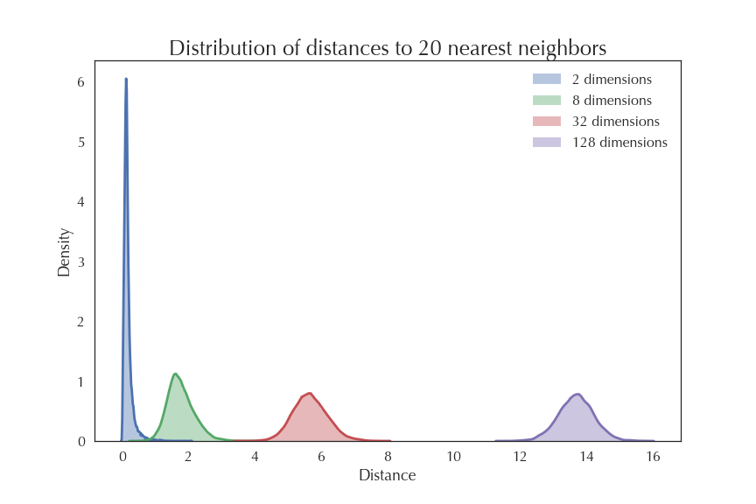
Notes:
Here we show a histogram of the distances to the 20 nearest neighbors of points randomly sampled in two dimensions, 8 dimensions, 32 dimensions, and 128 dimensions.
In 2D everything is near the origin, but as we go to higher dimensions the shortest distances are all quite long already.
In 128D, the distance between your first and 20th neighbors vary between roughly 12 and 15?

Slide 33
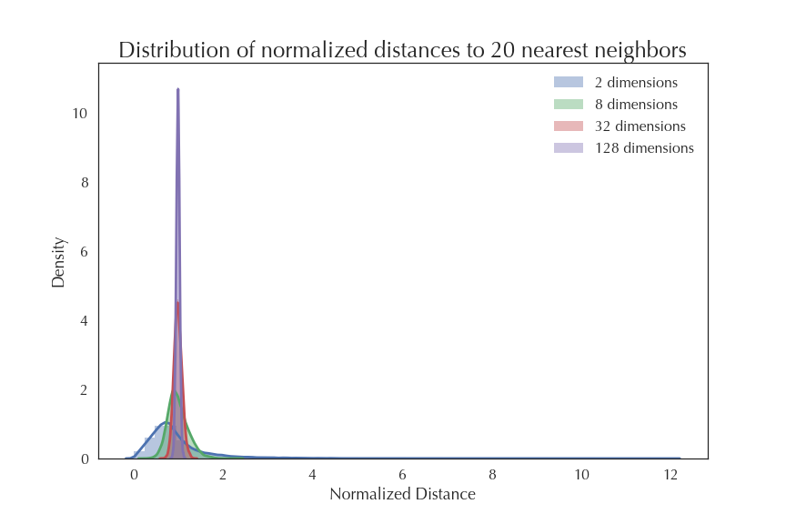
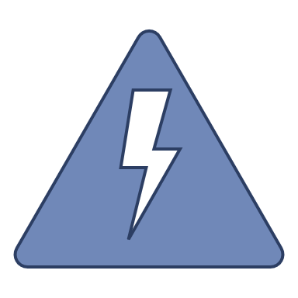
Single linkage
Notes:
So relatively speaking – if we scale by the largest distance we see for each dimensions – we get tighter and tighter distributions. Everything looks like it is the same distance apart in high dimensions. Brigde problems of single linkage is likely to happen in a high dimensional space.

Slide 34
Hubs
Notes:
Another annoying point is hubs.

Slide 35
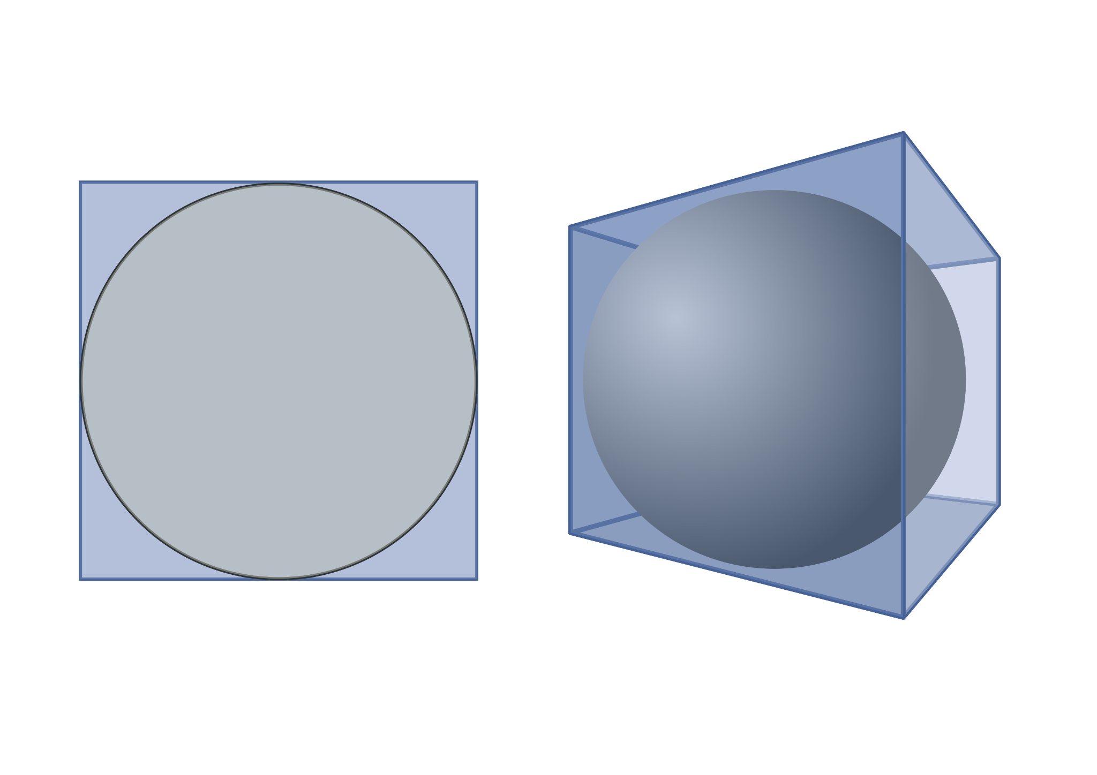
d=2
d=3
d=100?
…
Ratio of sphere volume to box volume?
Notes:
In high dimensions all data lives in the “corners”.
What do we mean? In 2 and 3d , the ratio of the sphere volume to the box volume is quite large. But as the dimension goes up, this ratio shrinks to zero – all the volume is in the corners of the box and none is in the sphere.

Slide 36
Anything slightly closer to the center becomes the nearest neighbor of most points!
K-means / SL
Notes:
What is the effect of that? – Anything that is slightly closer to the center is viewed as “close” by any point in a corner – because most points are in their own corner, and corners are all far away from each other.
K-means’ centroids, being the average of points, will likely be hubs themselves.
Again, hubs will make the problem of bridging clusters for single linkage … much more common.

Slide 37
Density
Notes:
Finally… density.

Slide 38
Volume grows exponentially with dimension
Notes:
Volume grows exponentially with dimension … we expect that.

Slide 39
So we need exponentially more data to obtain the same density!
HDBSCAN
Notes:
So we will never have enough have data to properly estimate densities.
Unless the data lives on some manifold of lower intrinsic dimension.
And it turns out that in real cases, this is what happens!

Slide 40
Applying dimension reduction
Notes:
Does dimension reduction help at all?

Slide 41
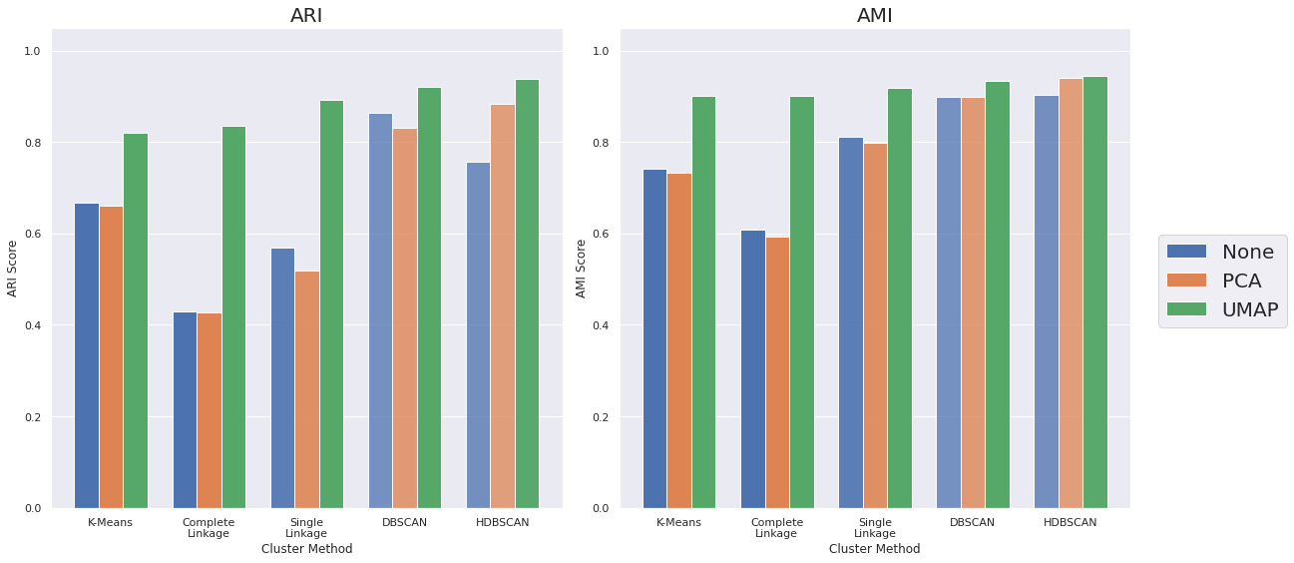
Pen Digits
Notes:
We apply 2 dimension reduction techniques: PCA which is a linear projection to a lower dimensional space that preserves the variance as much as possible, and UMAP that I will describe in a few slides.
We see that with UMAP, everything just does better. Even K-Means and complete linkage get good results, and the density based algorithms now cluster pretty much all the data. PCA doesn’t seem to help much.

Slide 42
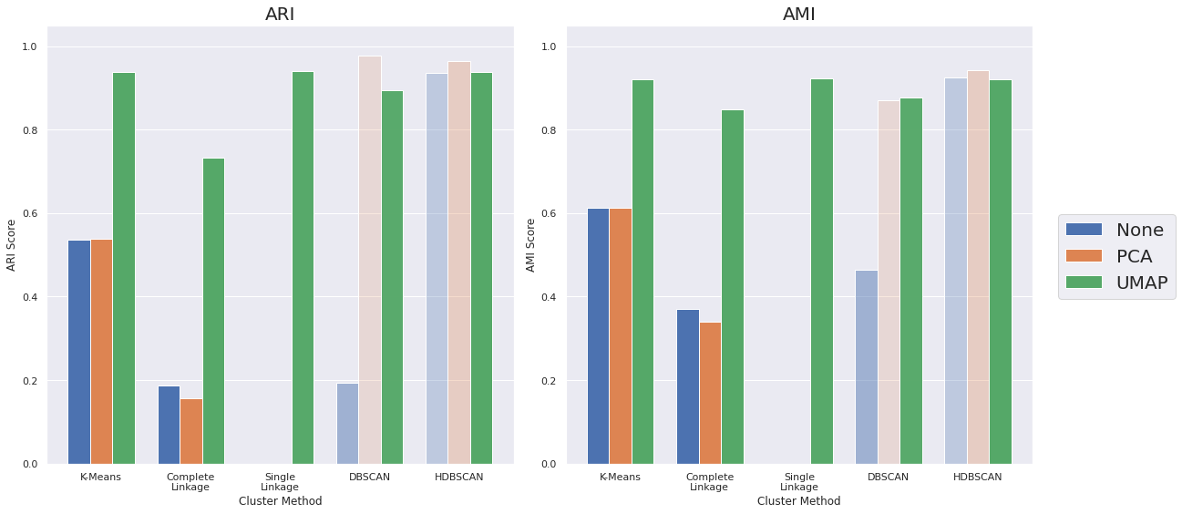
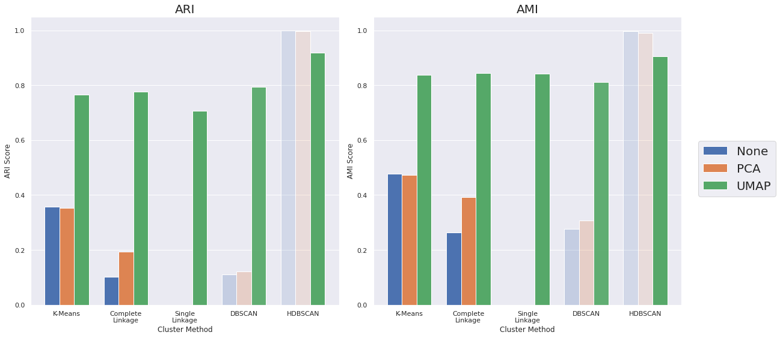
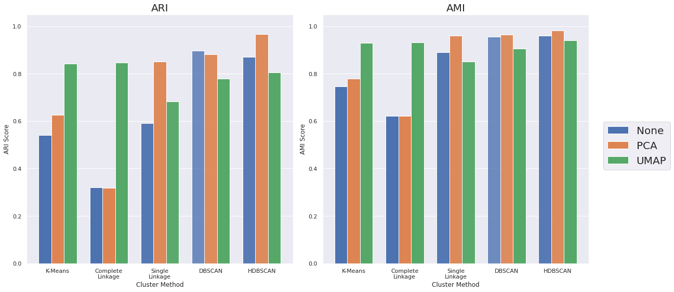
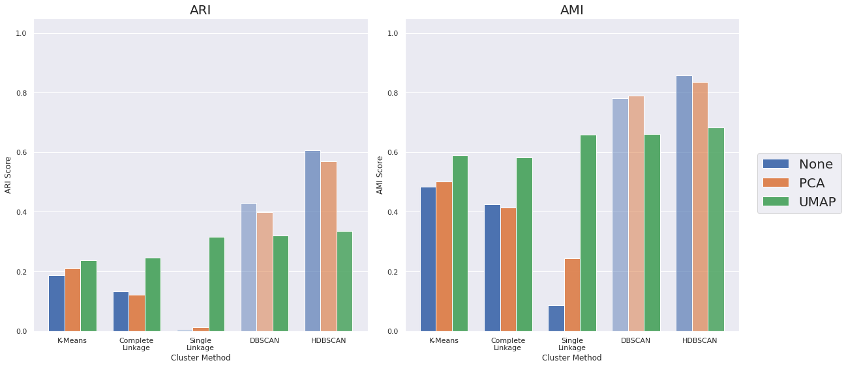
USPS Digits
MNIST Digits
COIL-20 Objects
Sheffield Buildings
Notes:
Apart for the COIL dataset, UMAP helps on all datasets.
For USPS and MNIST: UMAP helps a lot, for all clustering algorithms.
For COIL: a linear reduction such as PCA works better for single linkage and density-based approaches. UMAP helps with the “spherical” assumption.
For Buildings: One problem we observe with the original data or the PCA reduced data, is that the density-based clustering algorithms identify a large proportion of the points as noise points. UMAP doesn't suffer from this behaviour as much.
Overall, the UMAP representation yields better results with any of the clustering algorithms, but generally performs better with HDBSCAN.
So, overall UMAP+HDBSCAN produce better cluster while clustering a larger proportion of points.

Slide 43
Uniform Manifold Approximation and Projection
Notes:
What is UMAP? – in 3 slides!

Slide 44
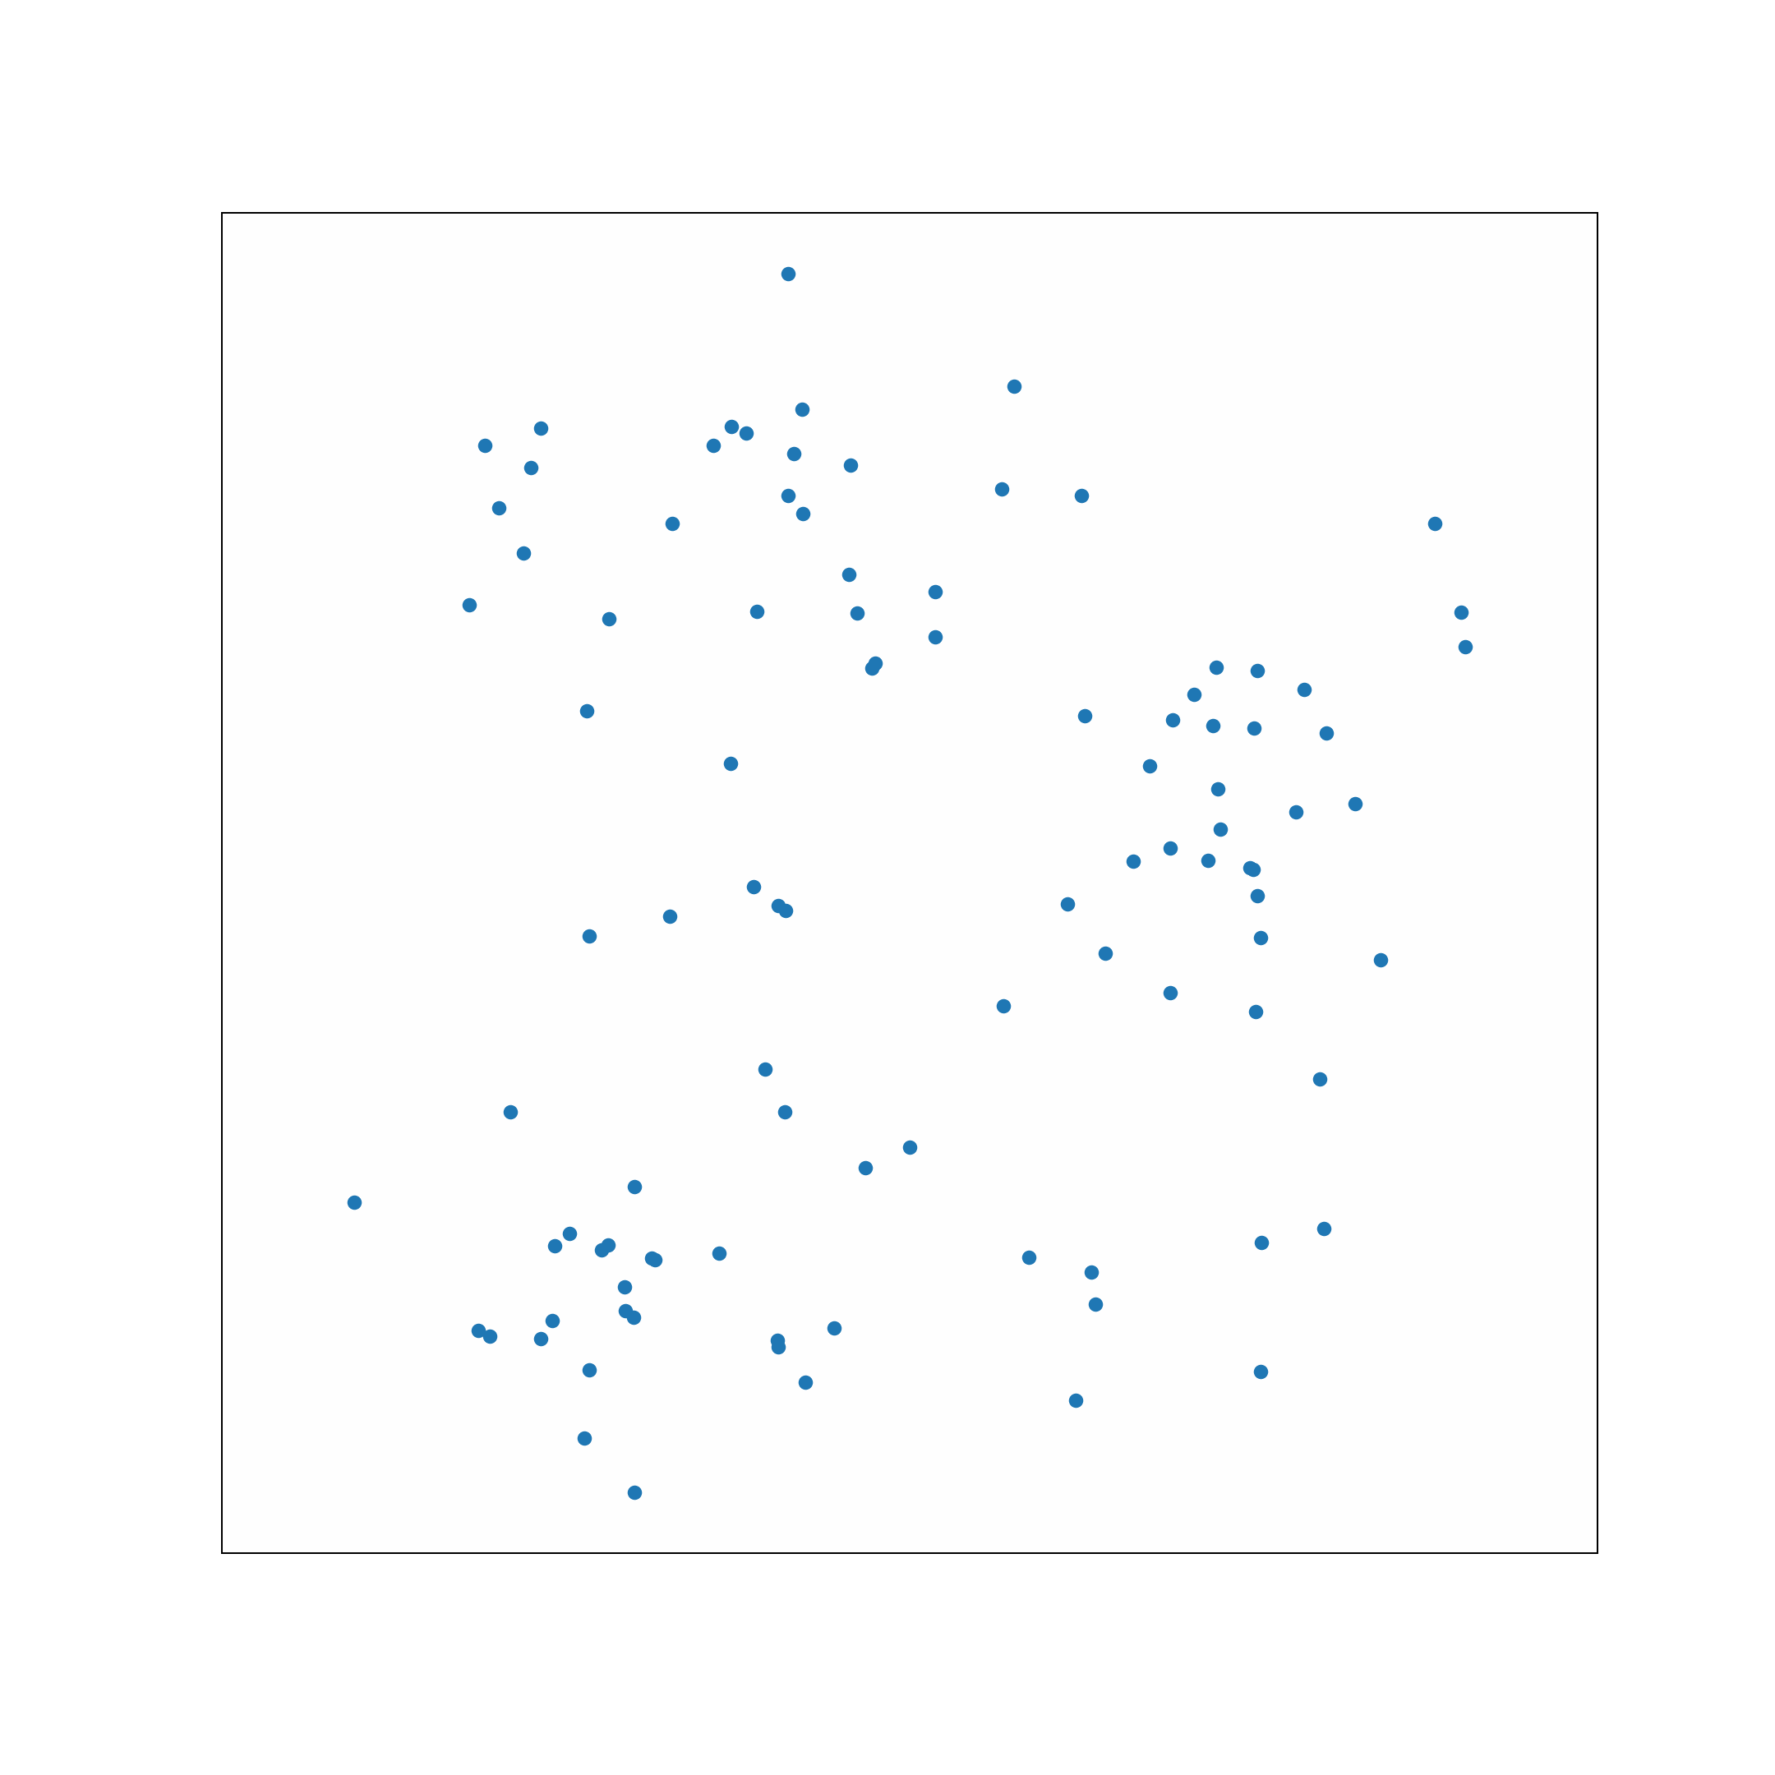
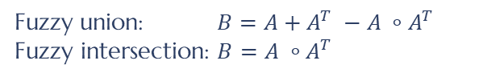
Fuzzy union: $B=A+A^{T} −A ∘A^{T}$
$$\text{Fuzzy} \text{intersection}\text{: }B=A ∘A^{T}$$
Notes:
UMAP starts by constructing a k-NN graph, as a weighted directed graph. The weights depend on the distance to the closest neighbor, and are normalized so that the weighted degree of all nodes is a constant.
It then makes an undirected graph (which we will call the UMAP graph) by taking the fuzzy union or fuzzy intersection of the directed edges.

Slide 45
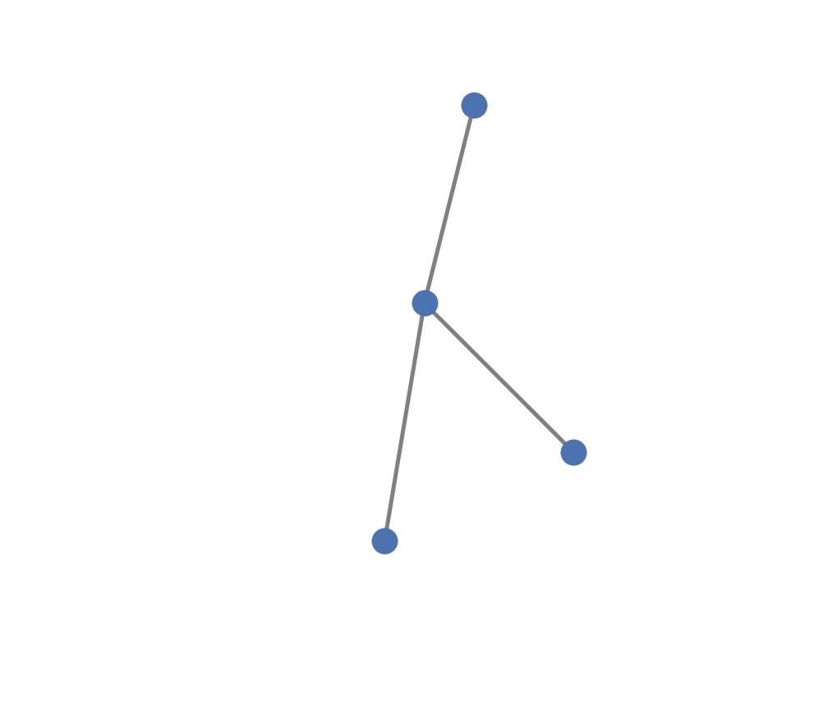
Graph Layout (spectral initialization)
Notes:
UMAP uses a gradient descent to optimize the cross entropy of this graph in the two spaces: before and after reduction.
In the gradient descent, nodes have a repulsive force between them (decaying with distance) . Nodes connected by edges have an attractive force pulling them together.
This is run for a pre-determined number of epochs, and the forces reduces with the number of epochs.

Slide 46
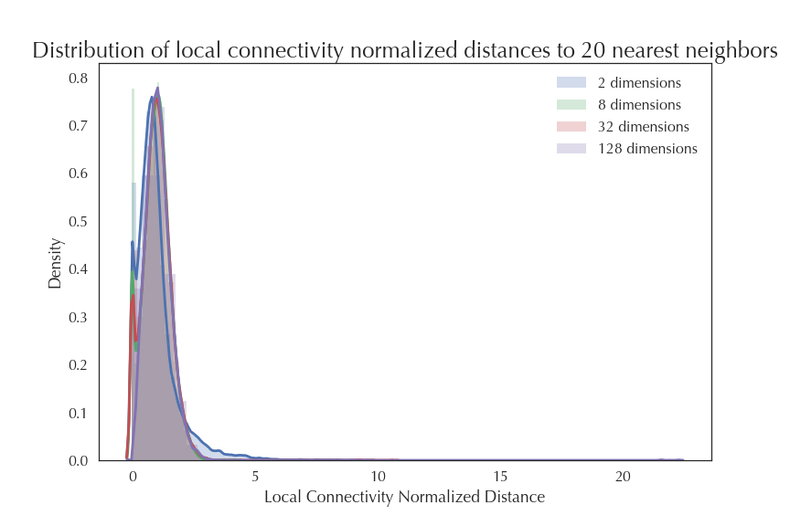
Notes:
The effect of this is that our nearest distance distributions now all look roughly the same regardless of the ambient dimensionality of the space.

Slide 47
UMAP on our datasets

Slide 48
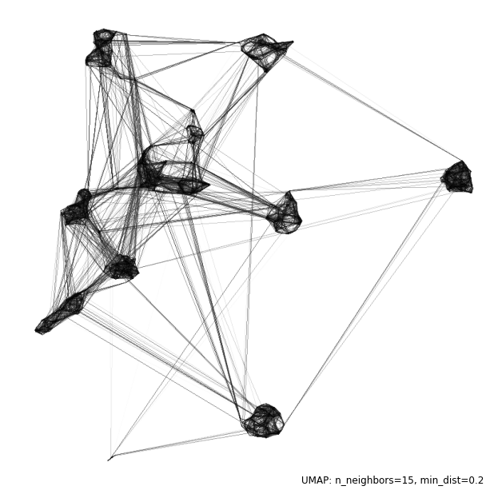
Pen Digits
Notes:
Here is a plot of the UMAP generated graph with vertices placed where the UMAP 2d layout would put them. You can see the nice dense clusters in the layout. But there are also a lot of edges between the clusters.

Slide 49
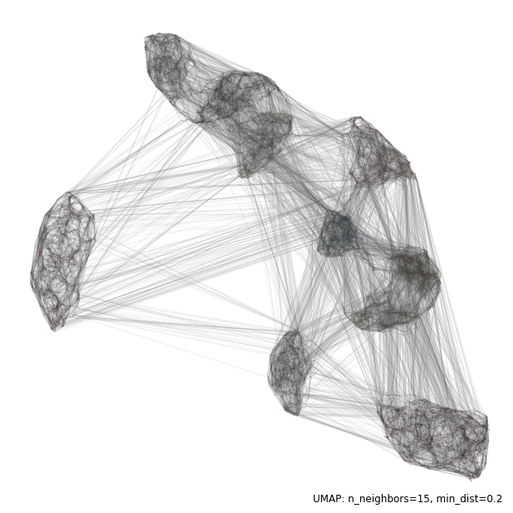
USPS Digits
Notes:
With USPS we see the same, but worse.

Slide 50
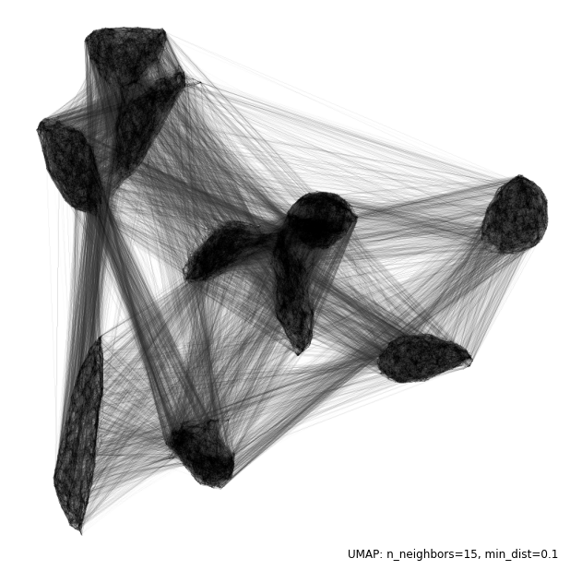
MNIST Digits
Notes:
MNIST shows the problem only gets worse.

Slide 51
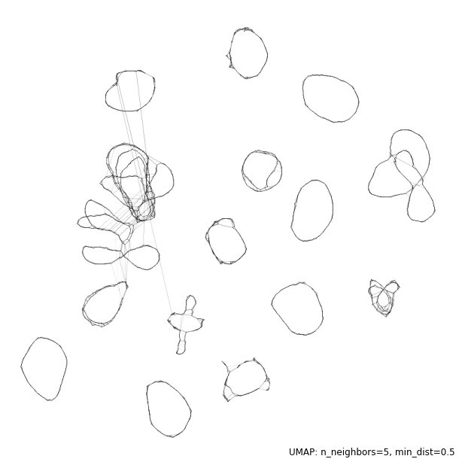
COIL-20 Objects
Notes:
With COIL we can see the circles due to the 360 degree rotation around each object. But even in this case there are some inter-cluster edges.

Slide 52
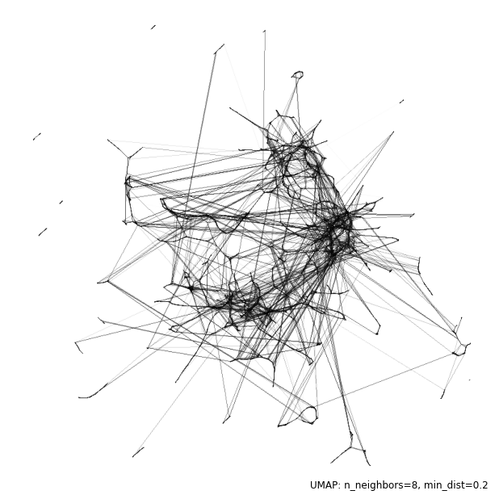
Sheffield Buildings
Notes:
And the building dataset shows why it is so hard: we don’t have high edge density.

Slide 53
Our question

Slide 54
For clustering high dimensional data, can we do better than UMAP + HDBSCAN (or faster)?
Notes:
Even though clustering high dimensional data is hard, in practice the pipeline UMAP-HDBSCAN has proven to be very successful in practice. But UMAP is not optimized for this particular task. Is the function UMAP aims at optimizing the right one for a clustering task? Is it over kill? Can we avoid some of the work? Can we improve and solve the high dimensional clustering properly?

Slide 55
Empirical study

Slide 56
Is the spectral initialization sufficient?
Notes:
UMAP initialized the points’ positions by finding the spectral embedding of the Laplacian of the graph.
Is this initialization sufficient for identifying clusters?

Slide 57
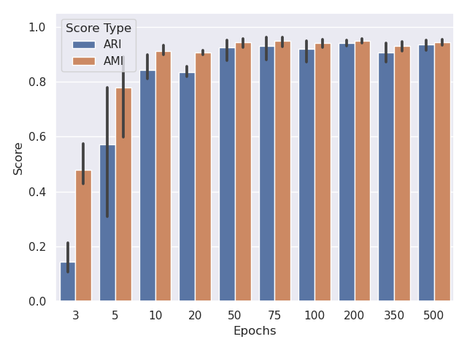
Pendigits
Notes:
Here, we apply UMAP to the dataset and restrict the gradient descent to 3, 5, 10 epochs. We run HDBSCAN on the resulting data.
Clearly, the initial spectral embedding is not precise enough to retrieve the clusters. However, the number of epochs required is not very high before stabilizing. There is no big improvements after 50 epochs, UMAP’s default is 500.

Slide 58
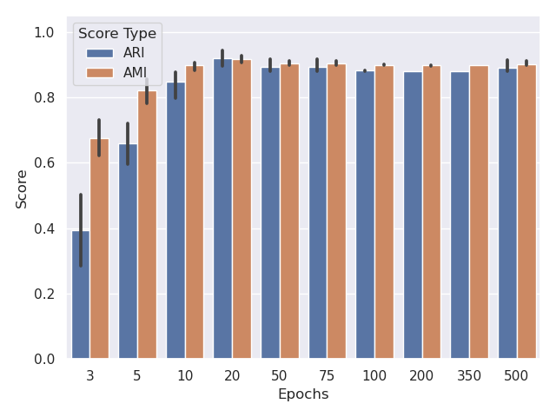
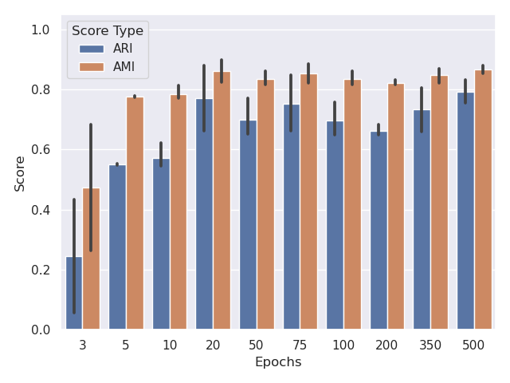
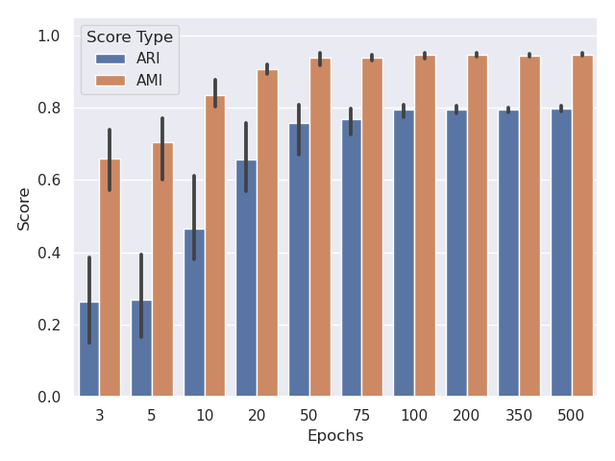
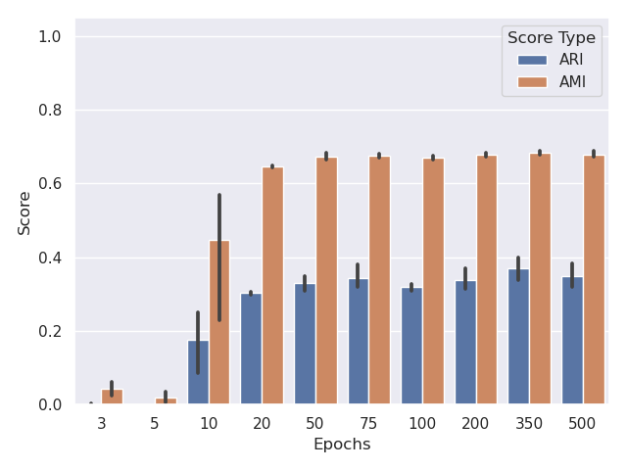
USPS Digits
MNIST Digits
COIL-20 Objects
Sheffield Buildings
Notes:
This observation holds for all of our datasets: not much improvement after roughly 50 epochs.
So this tells us that the gradient descent that moves points around is a necessary step in this process.

Slide 59
Graph Clustering Algorithms?
Notes:
When looking at the plots of the UMAP graphs, we have observed high internal edge density for most of the datasets. Could some graph clustering algorithms capture these clusters? That’s what modularity is for.

Slide 60
Proportion of edges that stay within clusters above expected
Modularity
Notes:
Given a clustering of vertices, modularity is just the proportion of edges that stay within a cluster above the expected number of within-cluster edges (under a null model).
We look for a clustering such that edges are much denser within cluster than expected at random.

Slide 61
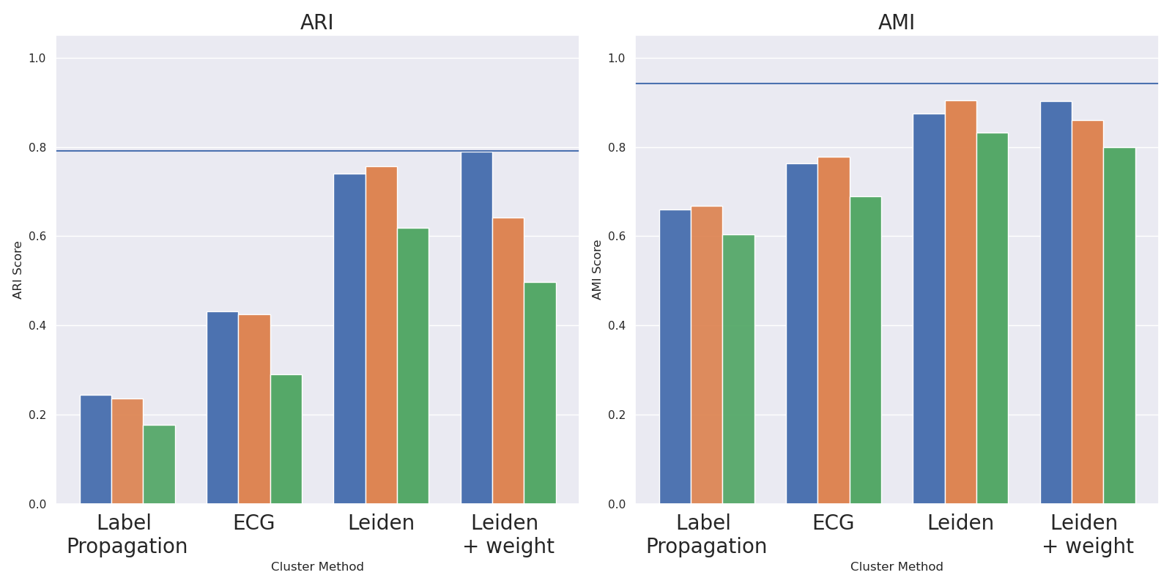
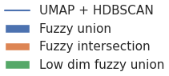
COIL-20 Objects
Notes:
We have tested a number of clustering algorithms (more than what is displayed here), we display only 3 of them. - Label propagation is an algorithm where each vertex sends it’s cluster information to its neighbors and each vertex decides on it’s label via a majority vote. - Ensemble Graph Clustering is a consensus algorithm based on an ensemble of Louvain where Louvain is a modularity optimization algorithm. - Leiden, is also a modularity optimization algorithm . It fixes some of Louvain’s issues and it is faster. We run it on weighted and unweighted graph versions, where the weights are the UMAP weights.
All these algorithms are run on 3 different graph representations of the data (1) fuzzy union, (2) fuzzy intersection. The third one is the nearest neighbor graph of the data *once projected* to the lower dimensional space with UMAP.
What do we see? For the COIL objects – a very regular dataset – Leiden yields good results on the fuzzy union, doing just as good as UMAP and HDBSCAN. Louvain yields results very similar to Leiden.
The Ensemble suffers from yielding very fine partitions, breaks the graph too much. This could be a consequence of the graph containing a lot of local structure (triangles).
Label propagation does not work well.

Slide 62
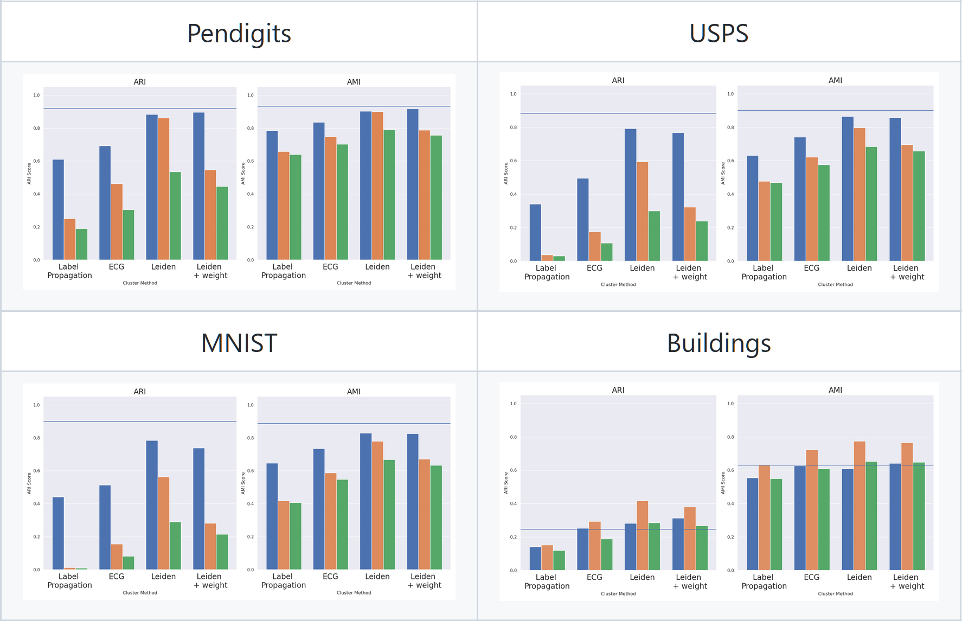
Notes:
For the other datasets, we see that Leiden on the fuzzy union graph is performing well. It only outperforms our baseline in the Buildings case but still has a very low ARI value. Overall, the baseline (UMAP and HDBSCAN) just does better.
Interestingly, using graph clustering algorithms to cluster the nearest neighbour graph of the low dimensional points obtained after UMAP, do not yield good results. We were wondering if the new neighbors obtained in the low dimensional space would improve the clustering results, but no. On average, points in high and low dimension share 60% of their neighbors. So the neighborhoods are quite different (before and after UMAP).
In all cases, maybe apart from the Buildings, Label propagation does not perform well. The reason why I kept it in this comparison, is that it has something similar to UMAP in a way. In Label propagation, points will influence their neighbors’ state by informing them of their own state/cluster id. In UMAP, points will also influence the position of their neighbors by informing them of their own position (and attracting them). But non-neighbors also play a role in UMAP via repulsive forces, while there is no such thing in label propagation. For graph clustering in general, the non-edge pairs have no impact. Could this provide good insights as to why UMAP is succeeding?

Slide 63
Fair comparison with baseline? HDBSCAN does not cluster every point…
Notes:
HDBSCAN does classify some points as being noise points. In our baseline evaluation, these points are discarded whereas they are not discarded from the graph clustering evaluation. This can make the comparison unfair, favoring our baseline. In order to run a fair comparison, we have looked at the number of noise points, and they were pretty small, and we also retrieved all noise points identified by HDBSCAN from the graph before performing the clustering with no big change to the results.

Slide 64
Is modularity the right notion?
Notes:
We know that modularity identifies groups having high edge density, which seems to be the right thing. However, there is more to it than just edge counts. For example…

Slide 65
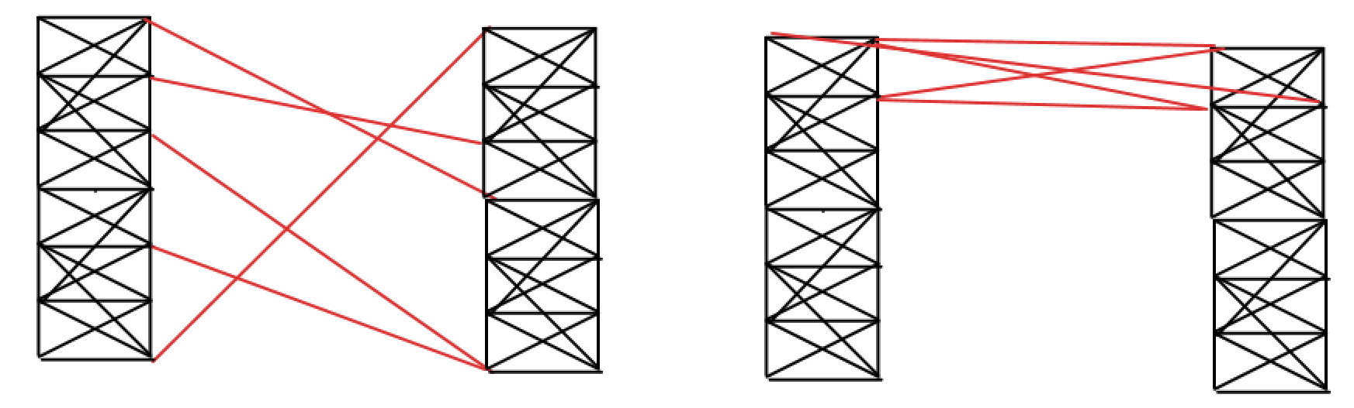
Notes:
Imagine two groups of points, in high dimension, having nearest neighbor graphs like the ones shown here. Algorithms optimizing modularity will not distinguish between those two situations before deciding to merge or not the two groups: it will simply count edges. Edge concentration is not incorporated. But what is edge concentration? Is preserving the higher order structure (triangles, 4,5-cliques) a key point to the function we should be optimizing?

Slide 66
Structure preservation?

Slide 67
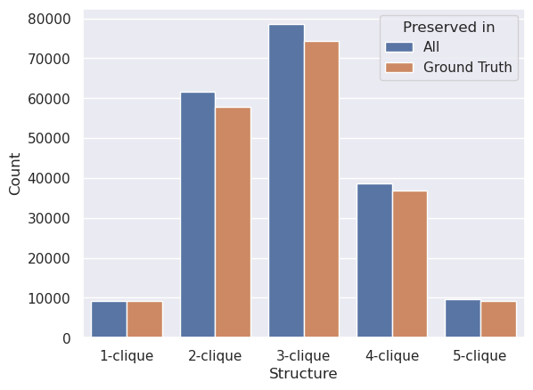
USPS Digits
Notes:
So here we count cliques in our graph.
First observation: the number of cliques of size 3, 4 or 5 is larger in a metric graph, that is in a graph that was constructed from points in a metric space than it is in regular small world graphs. The clustering coefficients (ratio of closed triangles out of all wedges) varies from 30% to 50% in our datasets.
Here, we are looking at the USPS. We show the total number of cliques in blue and the number of cliques that are entirely inside a ground truth part in orange. As we can see, the large majority of cliques lie within parts of the ground truth partition. The question we ask is: should we be minimizing the number of cliques broken by the clustering algorithm? What do our graph clustering do?

Slide 68
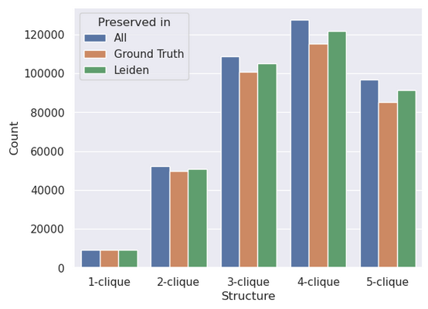
USPS Digits
Notes:
It turns out that the ground truth partition breaks more cliques than the modularity-based clustering algorithm Leiden. This is surprising.
However, preserving structure could be easy if the graph clustering algorithm does not break the dataset a lot… so let’s look at the parts sizes.

Slide 69
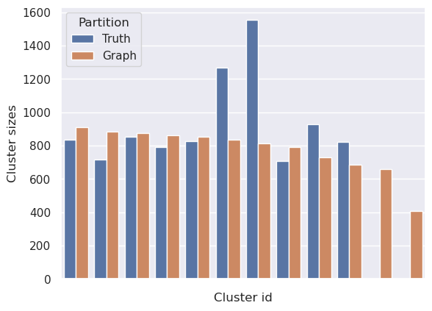
USPS Digits
Notes:
Still looking into USPS data. The true cluster sizes are shown in blue, and in orange we see the size of the Leiden parts. Leiden breaks the graph into a larger number of smaller parts, but is still able to break less triangles and higher order cliques than it should.
We have ran this on all 5 datasets and the conclusion is always the same.
It means that preserving higher order structures is not the right objective: we need to break some of these structures, but we must identify which ones. Let’s look into some examples.

Slide 70
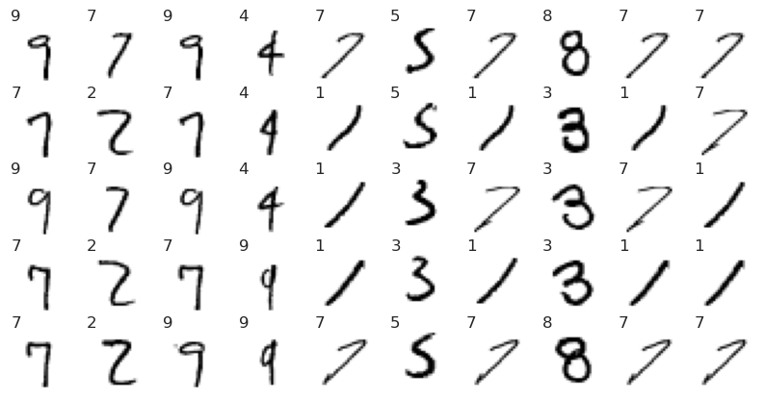
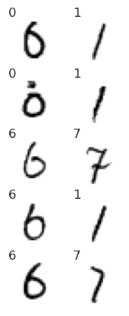
MNIST
Preserved by Leiden (not by HDBSCAN + UMAP)
Preserved by UMAP + HDBSCAN (not by Leiden)
Notes:
Here we show 5-cliques preserved by one clustering strategy and not by the other. We show cliques having no singleton class element (each class label appears at least twice).
These cliques have a big negative effect as they can really start gluing two groups together.
These unbroken cliques are also much more common with graph clustering algorithms than with UMAP and HDBSCAN (only had the 2 displayed).

Slide 71
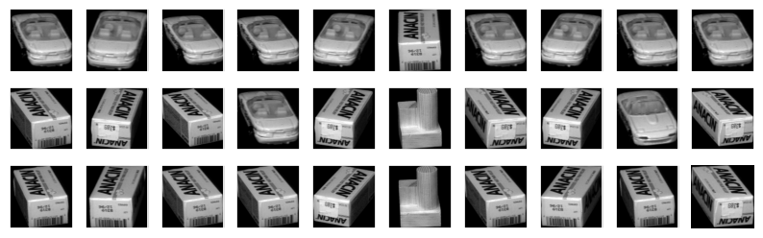
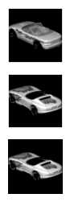
COIL
Preserved by Leiden (not by HDBSCAN + UMAP)
Preserved by UMAP + HDBSCAN (not by Leiden)
Notes:
Here we show triangles preserved by one clustering strategy and not by the other. Again, much more common when optimizing modularity and as we can see, the confusion occurs with a larger number of objects with Leiden: confusing a box, with a car, with a piece of wood (and with another car). UMAP is able to avoid these errors.

Slide 72

COIL
Notes:
Here, we look at UMAP positions of images.

Slide 73

COIL
Notes:
The red and green points are the positions of the 6 images highlighted. The set of points containing a single green marker, contains the two sets of cars. UMAP was not able to push them these two clusters apart as they are very similar. However, even if the box images and the one car image (in green) are similar, the repulsive forces in UMAP was able to push them apart. Same for the red examples.
Again, the right algorithm would need to be able to break these triangles. How do we identify them? Is there some extra information that could help distinguish between internal and external edges?

Slide 74

USPS: cliques’ min UMAP weights
Notes:
We have tried to identify which cliques to preserve by looking at aggregation of edge information at the clique level. The distributions of preserved (True) vs. broken (False) cliques of, for instance, minimum UMAP weight of clique edges, have very similar shape: both have the same high probability range.
Not too sure what to do from these observations, we decided to look more closely into edge properties.

Slide 75
External/internal edge properties
Notes:
We studied edge properties, our underlying goal being to be able to split edges into two groups: internal vs. external edges.

Slide 76

USPS Digits
Notes:
We’ve looked into a number of edge properties: blue is for internal edges and red is for external edges.
Note that we show the two distributions separately, but the raw counts are very small for the external edges as most edges are internal.
The edge betweenness, as expected, we do see a peak at the highest value for the external distribution. For the UMAP weights, we see a heavier distribution for high values for internal edges, as expected. But we also see a large peak of external edges having a UMAP weight of 1.
The next one shows the average of the distances of the endpoints to their respective nearest neighbors in the original space. We observe that internal edges tend to have endpoints closer to their nearest neighbor (this can be thought of as a rough estimate for density, it’s inverse).
Same kind of separation is observed for the number of triangles edges are part of. However, the most impressive separation comes from the change in the distance before and after UMAP. We did not find any other edge property that separates the two edge classes as well as the distance in the low dimensional space.

Slide 77
Partition graph using “robust” single linkage on sparse dissimilarities
Notes:
So the edge properties are not perfectly separable, but can they still be used for clustering? In a robust single linkage approach. We have tried some, with no big success so far.

Slide 78
(1) UMAP weights (2) Number of supporting triangles (3) Average of edge (and non-edge) weights + UMAP weight - Romeo and Juliet (4) Number of cycles of length 1, 3 and 4 (5) UMAP weight of modified high dimensional representations.
Sparse (dis -) similarities (inverse of - )
Notes:
Can we use the neighborhood of nodes (or their respective families’ opinion) and incorporate their opinion into a notion of similarity. This can then be fed this to a clustering algorithm (robust single linkage). We have tried a number of similarity notions. 1- UMAP as a baseline
2- Triangles: size of intersection of families
3- Average of edge and non-edge weights between the 2 neighborhoods. If the neighborhoods are not disjoint, I pretend it is and add edges of weight one between a node - in one neighborhood - and itself ( this is what the A + I is). I don't think this is the right thing to do as it dilutes the strength of the intersection too much.
4- Is a variation of 3-
5- High dimensional points are represented by their neighbors average. UMAP weight of this new representation.

Slide 79

Pen Digits
Notes:
Running robust single linkage on these edge dissimilarities did not perform well at all. These results can be taken with a grain of salt as I have not spent too much time on fine tuning anything. I still wanted to share this as it is the closest to what HDBSCAN is doing to the low dimensional distances. Still need to understand what is going wrong, or what I am doing wrong with this.

Slide 80

Pen Digits
Notes:
But what we have observed is that averaging the neighborhoods’ opinions tend to concentrate the similarity values.
The question remains: is there a proper similarity measure based on the graph topology (and other spatial information) that could lead to good single linkage clustering results?

Slide 81
Edge pruning instead of graph clustering
Notes:
Robust single linkage is one way to tackle this problem. Another would be to view this as an edge pruning process, keeping the remaining connected components. Can we find a similarity notion that would yield good results from edge pruning?
We have tried learning what information to use to define such a similarity by training an edge classifier from a set of features on all edges of all datasets.
Even if we did normalize properly the features, the edge feature vectors were not easily comparable between datasets. We still need to explore this to guide our search.

Slide 82
What next?
Notes:
So this was an overview of the exploration done so far. What next, this is more a question to you.

Slide 83
How to mimic UMAP’s repulsive forces?
Notes:
A very strong aspect of working in a metric space like UMAP does, is that when moving a single point, it affects the relation of this point to ALL other points. This is not easy to mimic on a graph, but the repulsive forces of UMAP seem to contribute a lot to the performance.
What could be done to mimic something like this?

Slide 84
Code and this slide deck: https://github.com/vpoulin/HighDimensionalClustering /notebooks/00-GettingStarted.ipynb /reports
Notes:
Again, if you want to play with this data, you can find some short notebooks to start with in this github repo. ☺

